Slide 1

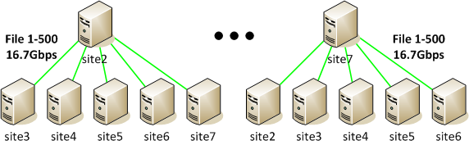
ExaO: Software Defined Data Distribution for Exascale Sciences
California Institute of Technology,
European Organization for Nuclear Research (CERN),
Tongji University, Tsinghua University, Yale University
ExaO leverages the emerging SDN technique to realize end-to-end orchestration of data flows involving host groups at different domains.
Architecture
On-demand, dynamic, minimal network state abstraction to provide global, real-time, inter-domain network view
Centralized, file-level transfer scheduling to achieve high transfer concurrency
Global, dynamic network resource allocation among flows to achieve high network utilization and low transfer delay
Demonstration: Distributing A Dataset to All the Sites
Dataset X (3000 50GB files)
Source site splits uplink bandwidth to all destination sites with different file groups
Destination sites become file providers to each other after receiving from source
Total link utilization: 85.71%
Presentations will happen at
3:00pm Tuesday; 2:00pm Wednesday; 10:30am Thursday.
Demos will last all three days!
Please stop by booth 2537 (the Caltech Booth).
For more information, please contact us.
supersdnprogramming@gmail.com

